Slide 1
Data Screening

Slide 2
What is it?
Data screening is very important to make sure you’ve met all your assumptions, outliers, and error problems. Each type of analysis will have different types of data screening. This lecture lists all the types, and check out the individual analysis for the important ones.

Slide 3
BIG IMPORTANT RULE
Hypothesis testing: Traditionally we use p < .05 (so you want values less than .05 because that’s what you are trying to find … statistically significant).

Slide 4
BIG IMPORTANT RULE
Data screening: We want to use p < .001 because we want to make sure things are really crazy before we fix/delete/etc. If the scores are less than .1% then it’s really, really different/skewed/what have you, so you would want to fix it.

Slide 5
The Order
IN THIS ORDER:
Accuracy
Missing
Outliers
Assumptions:
Additivity
Normality
Linearity
Homogeneity / Homoscedasticity

Slide 6
Accuracy
Check for typos and problems with the dataset.
Generally, you are looking for values that are out of range.
Check out min and max to see if they are within what you would expect.
Fix’em! Or delete that data point. Do not delete the whole person, just the wrong data point.

Slide 7
Missing Data
Two types of missing data:
MCAR – missing completely at random (you want this)
MCAR – probably caused by skipping a question or missing a trial.

Slide 8
Missing Data
Two types of missing data:
MNAR – missing not at random
MNAR – may be the question that’s causing a problem.
For instance, what if you surveyed campus about alcohol abuse? What does it mean if everyone skips the same question?

Slide 9
Missing Data
What can I do?
MNAR – exclude or eliminate the data
MCAR – replace the data with a special function

Slide 10
Missing Data
How much can I replace?
Depends on your sample size – in large datasets <=5% is ok.
The 5% rule applies either across (by participant – how much data are they missing?) or down (by variable – how much of that variable is missing).
Small samples = you may need to collect more data.

Slide 11
Missing Data
What should I replace?
Do not replace categorical variables.
Do not replace demographic variables.
Do not replace data that is MNAR.
Most people replace continuous variables (interval / ratio).

Slide 12
Missing Data
How to replace?
Old ways to replace:
Mean substitution – used to be a popular way to fill in data (cuz it was easy, but now most people don’t recommend this solution).
Regression – uses the data given and estimates the missing values

Slide 13
Missing Data
Problems with the old ways:
Conservative – doesn’t change the mean values used to find significant differences
Does reduce the variance, which may cause significance tests to change with a lot of missing data

Slide 14
Missing Data
New fancy ways to replace
Expected maximization – now considered the best at replacing missing data – uses multiple imputation.
Creates an expected values set for each missing point
Using matrix algebra, the program estimates the probability of each value and picks the highest one

Slide 15
Missing Data
Practical point here:
Noncompleters
Breaking apart rows and columns for replacement
Take off the bad rows
Take off the bad columns
Replace data
Join back together
Columns together
Rows together

Slide 16
Outliers
Outliers are case(s) with extreme value on one variable or multiple variables.
Univariate outliers: you are an outlier for one variable.
Multivariate outliers: you are an outlier for multiple variables. Your pattern of data is weird.

Slide 17
Outliers
You can check for univariate outliers, but when you have a big dataset, that’s really not necessary.
We will cover how to check for univariate outliers when necessary, since it really only applies to those analyses (when you have 1 DV like ANOVA).

Slide 18
Outliers
Multivariate – check with Mahalanobis distance.
Mahalanobis distance – distance of a case from the centroid of rest of cases. Centroid is created by plotting the means of the all the variables (like an average of averages), and then seeing how far each person’s scores are from the middle.

Slide 19
Outliers
How to check:
Create Mahalanobis scores.
Use the chi-square function to find the cut off score (anything past this score is an outlier).
df = the number of variables you are testing (important: testing! Not all the variables!)
Use the p < .001 value.

Slide 20
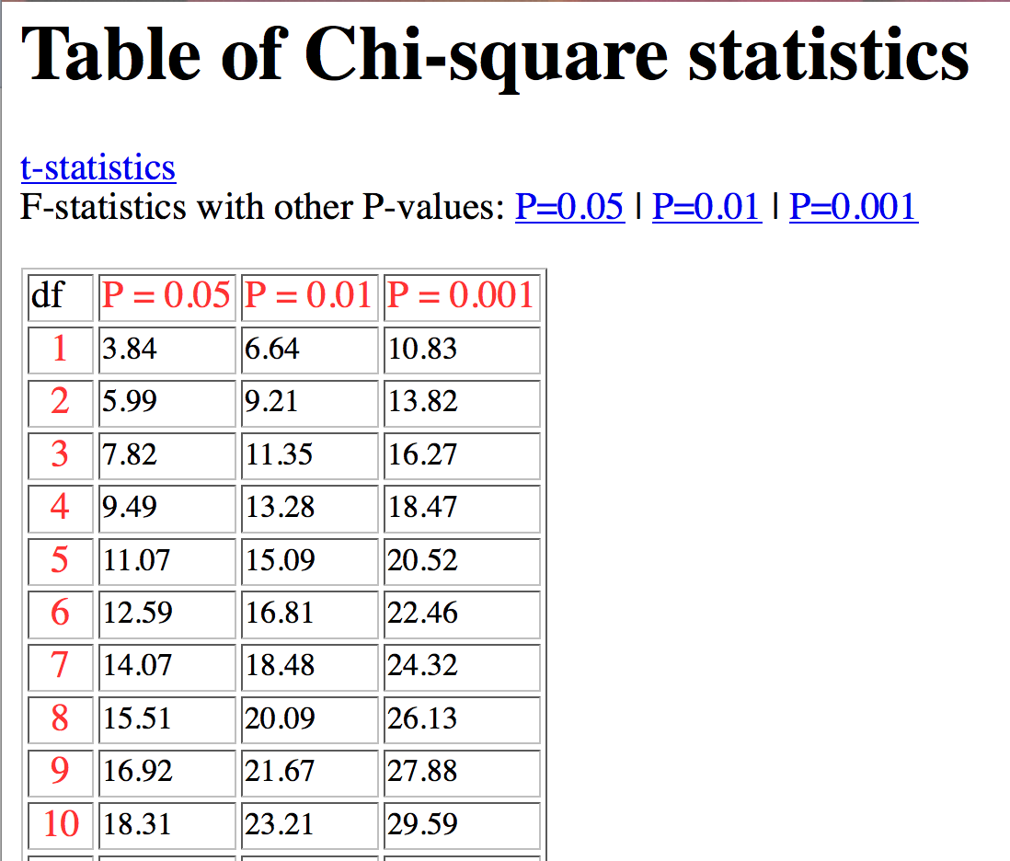
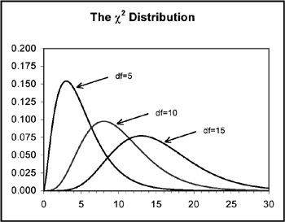
Outliers

Slide 21
Outliers
Regression based outlier analyses:
Discrepancy – a score that is far out on line but doesn’t influence regression slopes (measured by leverage values).
Leverage – a score that is far away from everyone else that affects the slope
Influence – product of leverage and discrepancy (measured by Cook’s values).

Slide 22
Outliers
What do I do with them when I find them?
Ask yourself:
Did they do the study correctly?
Are they part of the population you wanted?
Eliminate them
Leave them in

Slide 23
Assumptions Checks
Additivity
Normality
Linearity
Homogeneity
Homoscedasticity

Slide 24
Additivity
Additivity is the assumption that each variable adds something to the analysis.
Often, this assumption is thought of as the lack of multicollinearity.
Which is when variables are too highly correlated.
What is too high? General rule = r > .90

Slide 25
Additivity
So, we don’t want to use two variables in an analysis they are essentially the same.
Lowers power
Doesn’t run
Waste of time
If you get a “singular matrix” error, you’ve used two variables in an analysis that are too similar or the variance of a variable is essentially zero.

Slide 26
Assumption Checks
A quick note: for many of the statistical tests you would run, there are diagnostic plots / assumptions built into them. This guide lets you apply data screening to any analysis, if you wanted to learn one set of rules, rather than one for each analysis. (BUT there are still things that only apply to ANOVA that you’d want to add when you run ANOVA).

Slide 27
Assumptions
For ANOVA, t-tests, correlation: you will use a fake regression analyses – it’s considered fake because it’s not the real analysis, just a way to get the information you need to do data screening.
For regression based tests: you can run the real regression analysis to get the same information. The rules are altered slightly, so make sure you make notes in the regression section on what’s different.

Slide 28
Assumption Checks
The random thing and why chi square:
Why chi-square?
For many of these assumptions, the errors should be chi-square distributed (aka lots of small errors, only a few big ones).
However, the standardized errors should be normally distributed around zero (don’t get these two things confused – we want the actual error numbers to be chi-square distributed, the standardized ones to be normal).

Slide 29
Assumption Checks
For each of these assumptions, there are ways to check the univariate and multivariate issues.
Start with the multivariate → if it’s bad, then check the univariate.

Slide 30
Normality
The assumption of normality is that the sampling distribution is normal.
Not the sample.
Not the population.
Distribution bunnies to the rescue!

Slide 31
Normality
Multivariate Normality – each variable and all linear combinations of variables are normal
Given the Central Limit Theorem – with N > 30 tests are robust (meaning that you can violate this assumption and get reasonably accurate statistics).

Slide 32
Normality
So, the way to check for normality though, is to use the sample.
If N > 30, we tend not to worry too much.
If N < 30, and it’s bad, you may consider changing analyses.

Slide 33
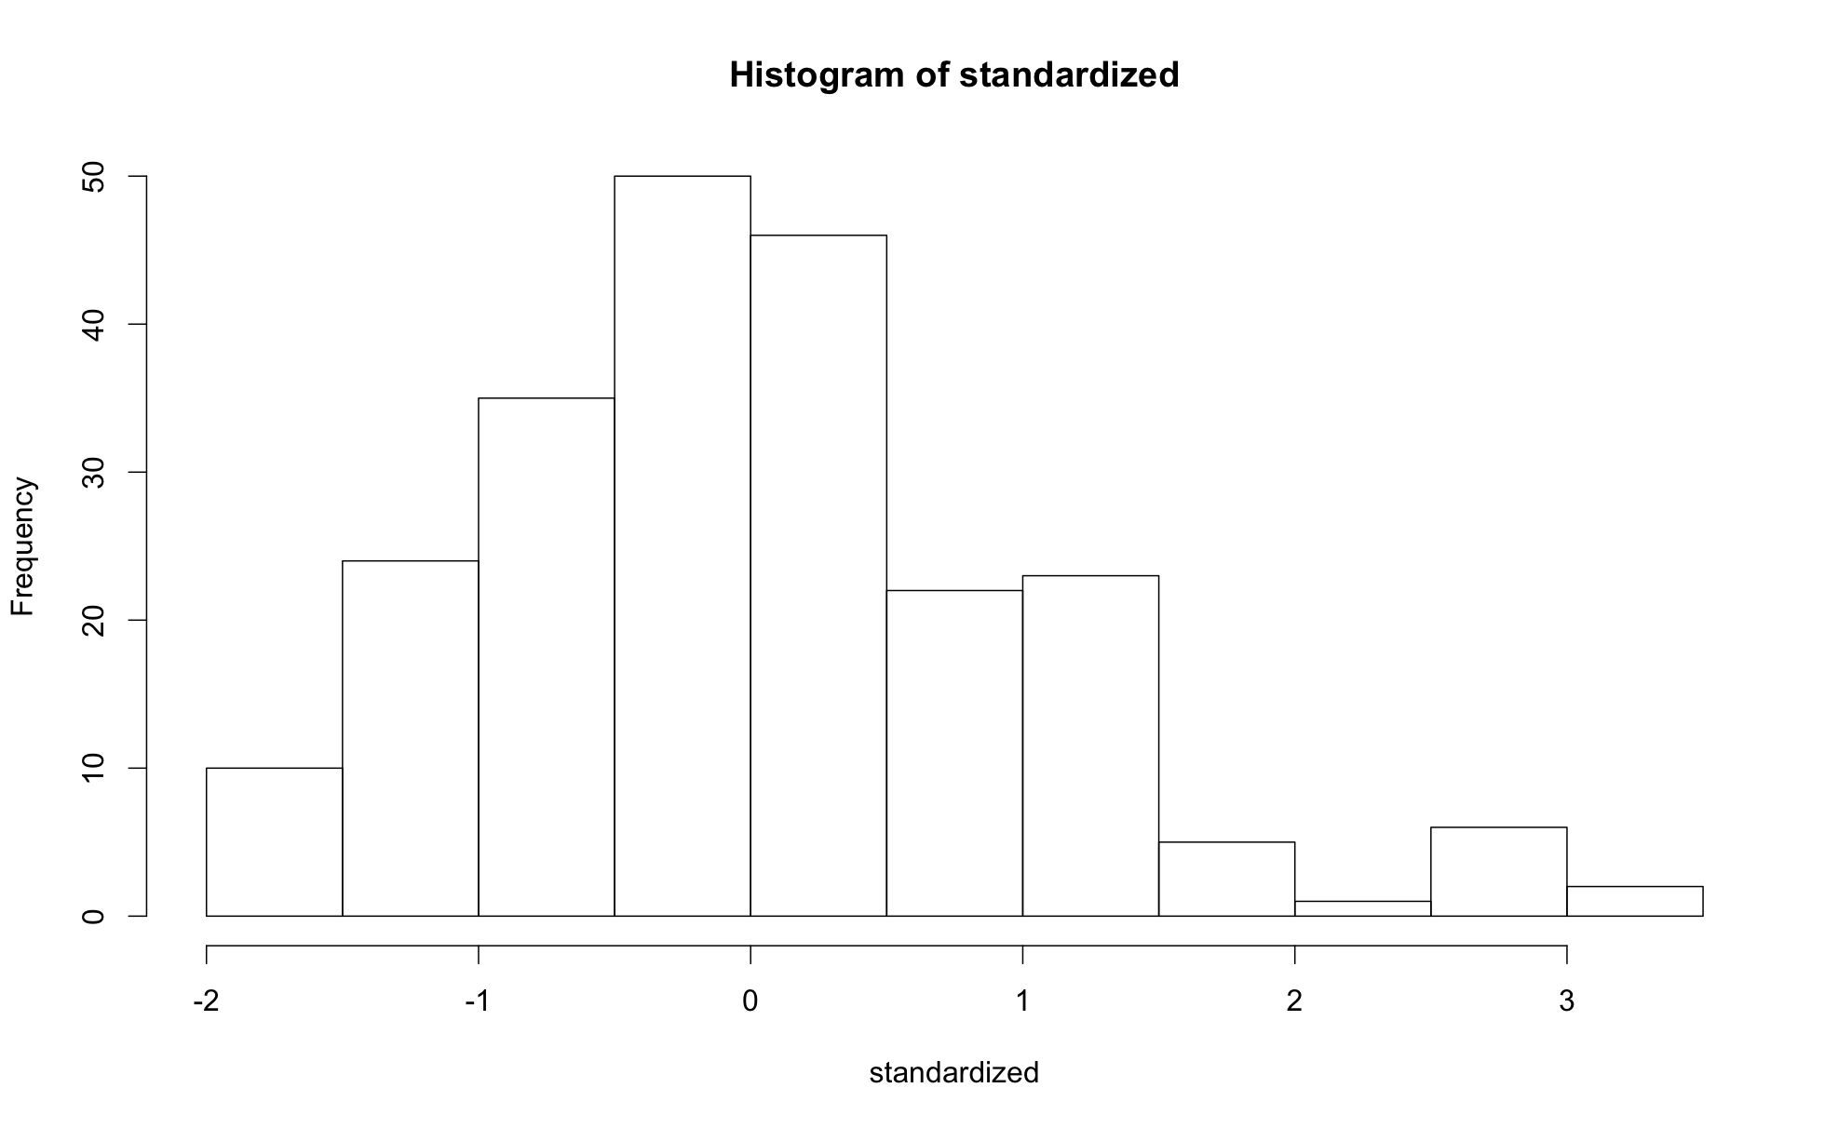

Slide 34
Linearity
Assumption that there is a straight line relationship between two variables (or the combination of all the variables)

Slide 35
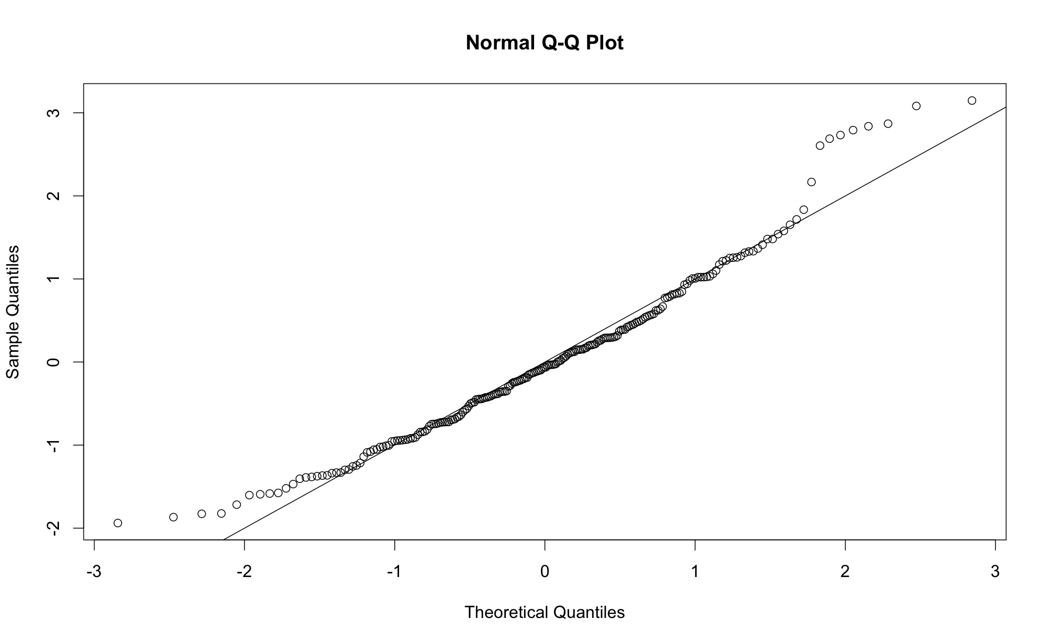

Slide 36
HomoG + S
Homogeneity: equal variances – the variables (or groups) have roughly equal variances.
Homoscedasticity: spread of the variance of a variable is the same across all values of the other variables.

Slide 37
HomoG + S
How to check them:
Both of these can be checked by looking at the residual scatterplot.
Fitted values = the predicted score for a person in your regression.
Residuals = the difference between the predicted score and a person’s actual score in the regression (y – y hat).

Slide 38
HomoG + S
How to check them:
We are plotting them against each other. In theory, the residuals should be randomly distributed (hence why we created a random variable to test with).
Therefore, they should look like a bunch of random dots.

Slide 39
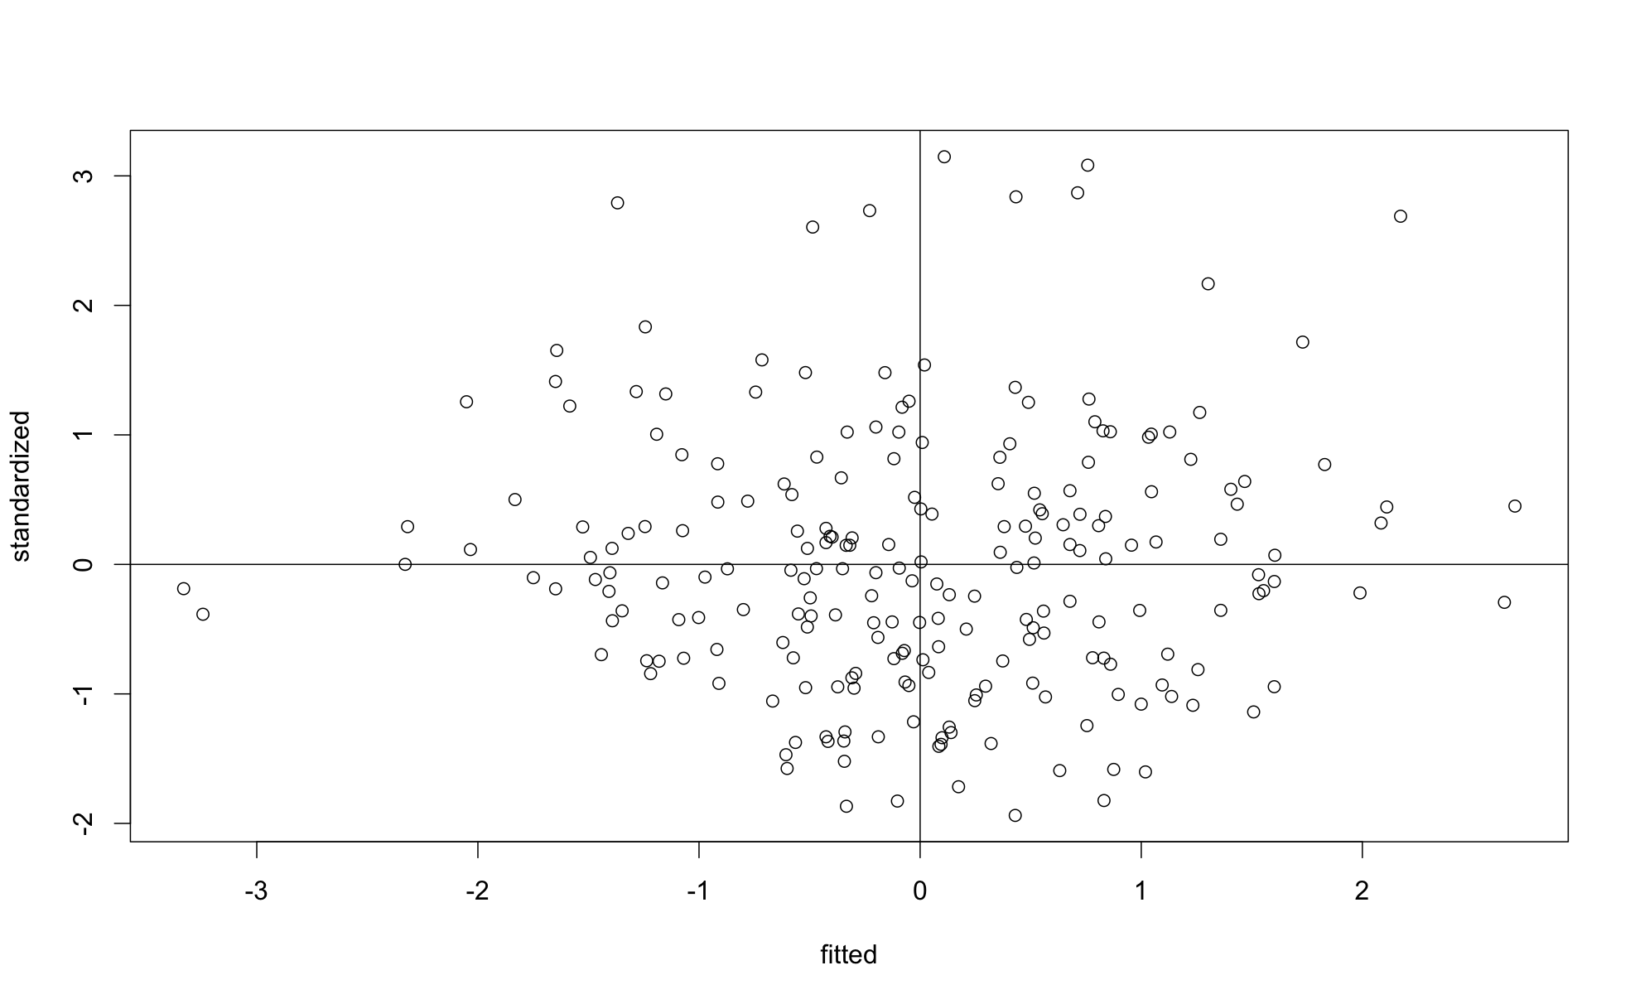

Slide 40
R-Tips
Multiple datasets will be created.
Remember to use the right data set.
Sometimes, you don’t have problems.
So, you would just SKIP a step making sure to use the right dataset.

